Slide 1
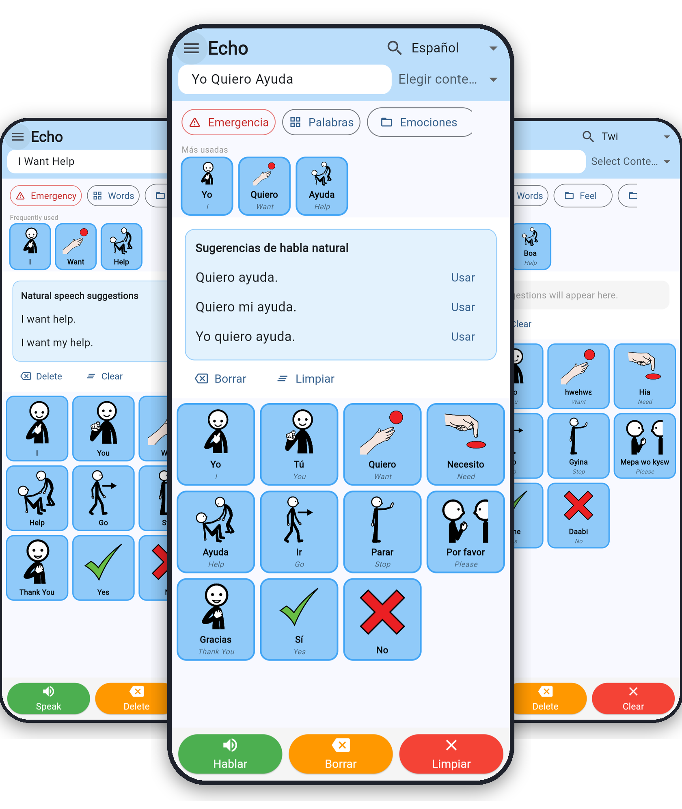



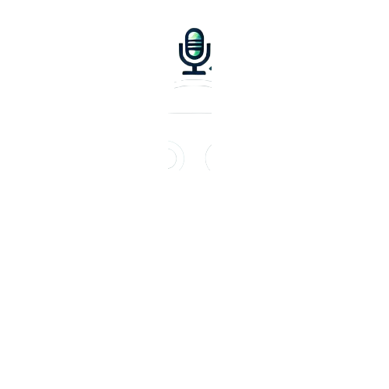

Echo
Offline-first AAC
in your own language
PAY
Team Handwave | Giving out voice
to everyone
01

Slide 2
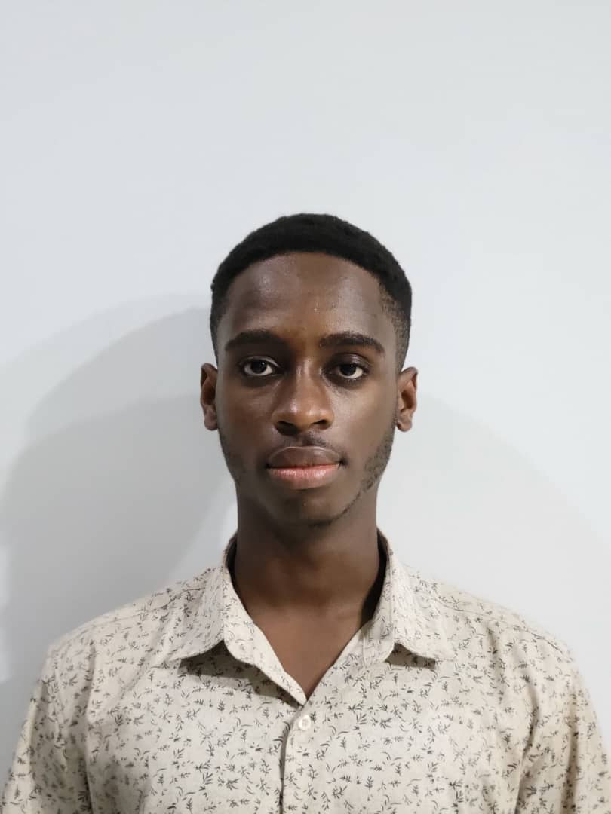

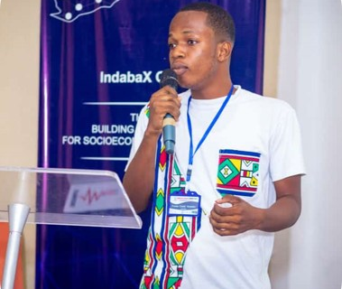
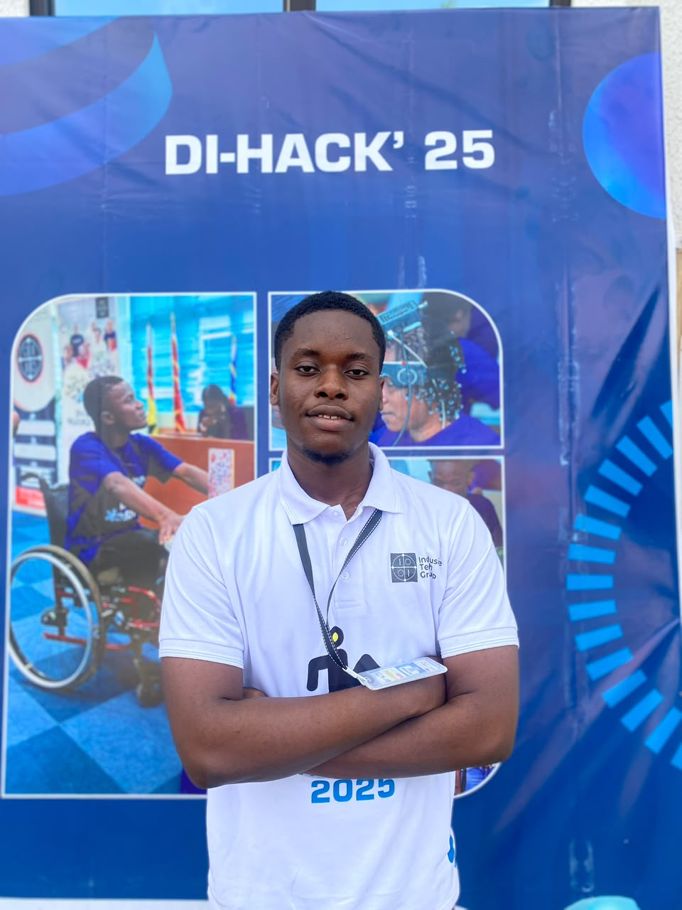

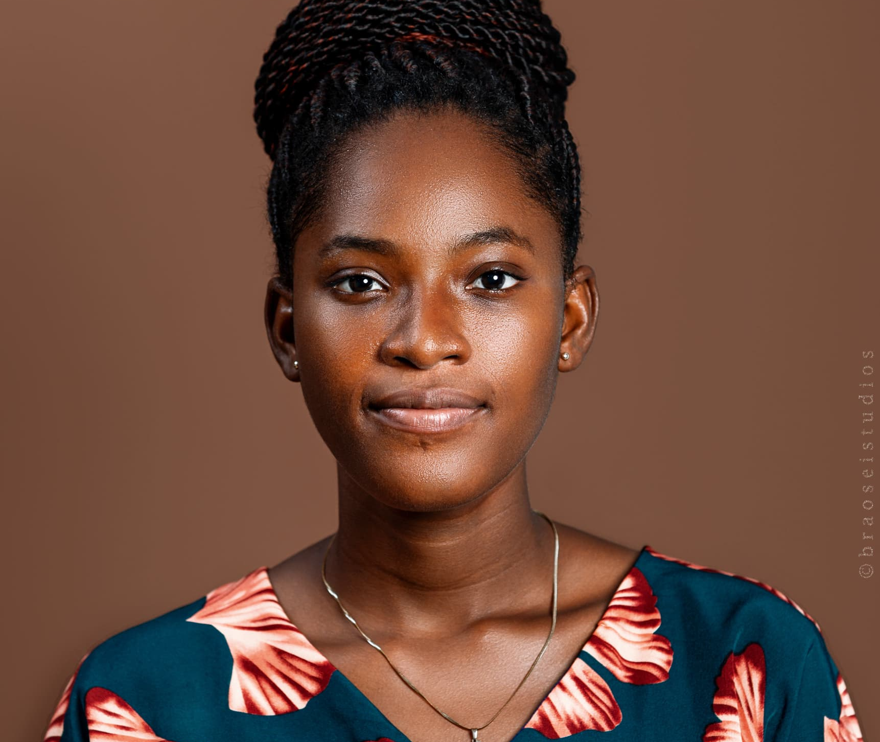
TEAM HANDWAVE
PROFESSIONAL TEAM
OFEI OBUOBISAH BEKOE
CLARENCE DANKWA MANU
Machine learning Engineer
Mobile Developer
Built the Flutter app: the communication board, Twi and Ga translation and speech through Khaya AI, and offline pictograms.
[Add this member’s role on Echo]
SYDNOR TWENEBOA OFORI- HANSON
Special Education Consultant
[Add this member’s role on Echo]
02

Slide 3
ECHO
TEAM HANDWAVE
INTRODUCTION
About 1.3 billion people (1 in 6) live with significant disability (WHO), and up to 1% have a speech, language or communication need, yet most communication apps are English-first, need the internet, and cover few languages.
Echo is an offline-first augmentative and alternative communication (AAC) app. Users tap pictogram tiles, choose their language, and hear the message spoken aloud. It is designed for any language.
Built by Team Handwave, Echo keeps the user in control of every word. We launch with English, Twi and Ga, then Spanish and French, advancing SDG 10: Reduced Inequalities.
03

Slide 4
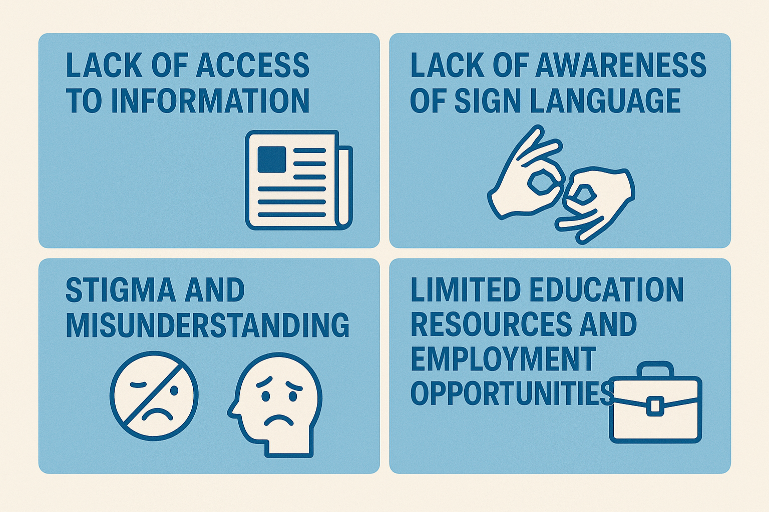
ECHO
PROBLEM STATEMENT
Most AAC apps are English-first, so millions of people must communicate in a language that is not their own.
Support for African and other underserved languages is limited, and many tools depend on an internet connection that is unreliable for many users.
Crowded screens with hundreds of buttons overwhelm users and caregivers, with little personalization beyond adding words.
Generic robotic voices and symbol libraries with no local foods, places or people do not reflect who the user is.
1.3 billion
1 in 127
people live with significant disability, 1 in 6 worldwide (WHO)
people is autistic (WHO, 2021)
Up to 1%
1 in 3
of people have a speech, language or communication need (Elsahar et al., 2019)
stroke survivors has aphasia (NIDCD)
Sources: WHO Disability fact sheet (2023); WHO Autism fact sheet (2025); Elsahar et al. (2019); NIDCD Aphasia.
04

Slide 5
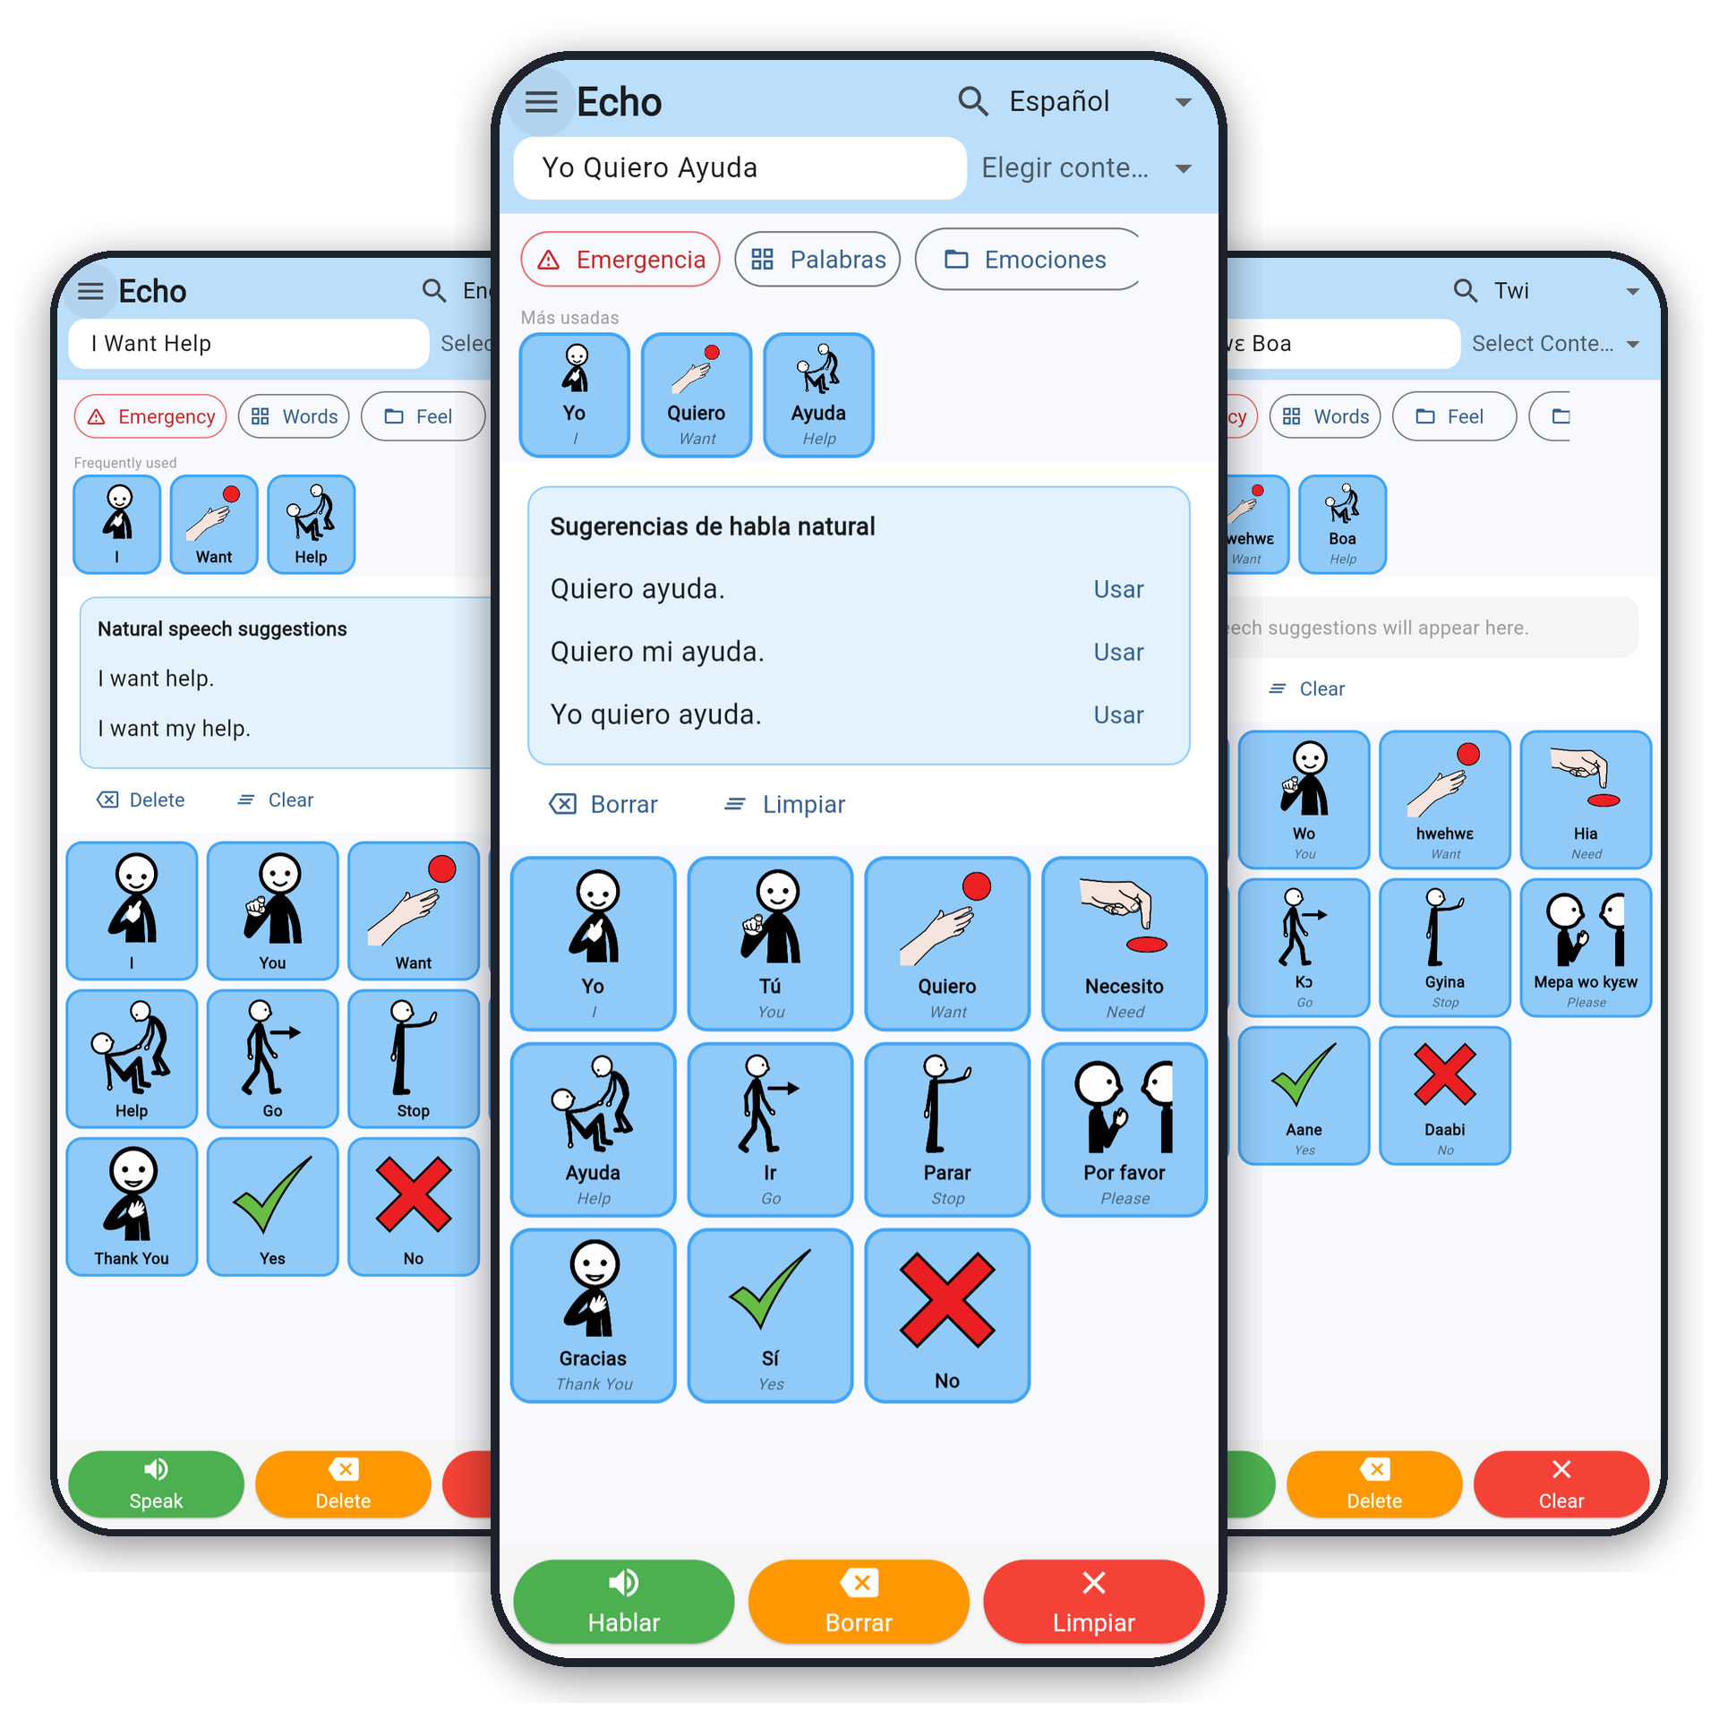
ECHO
Our Solution
Echo is a mobile-first AAC app built with a user-first mindset
Fixed core vocabulary, four collections and seven contexts. [Built]
Bilingual tiles and code-switching: English, Twi and Ga built, Spanish and French in progress.
Speaks aloud through Khaya AI, with phone voices for offline use. [Built · phone voices in progress]
Offline-first: 78 pictograms and photos ship in the app. [Built · data storage in progress]
Natural Speech suggestions and switch scanning. [Built as prototype]
PAY
05

Slide 6

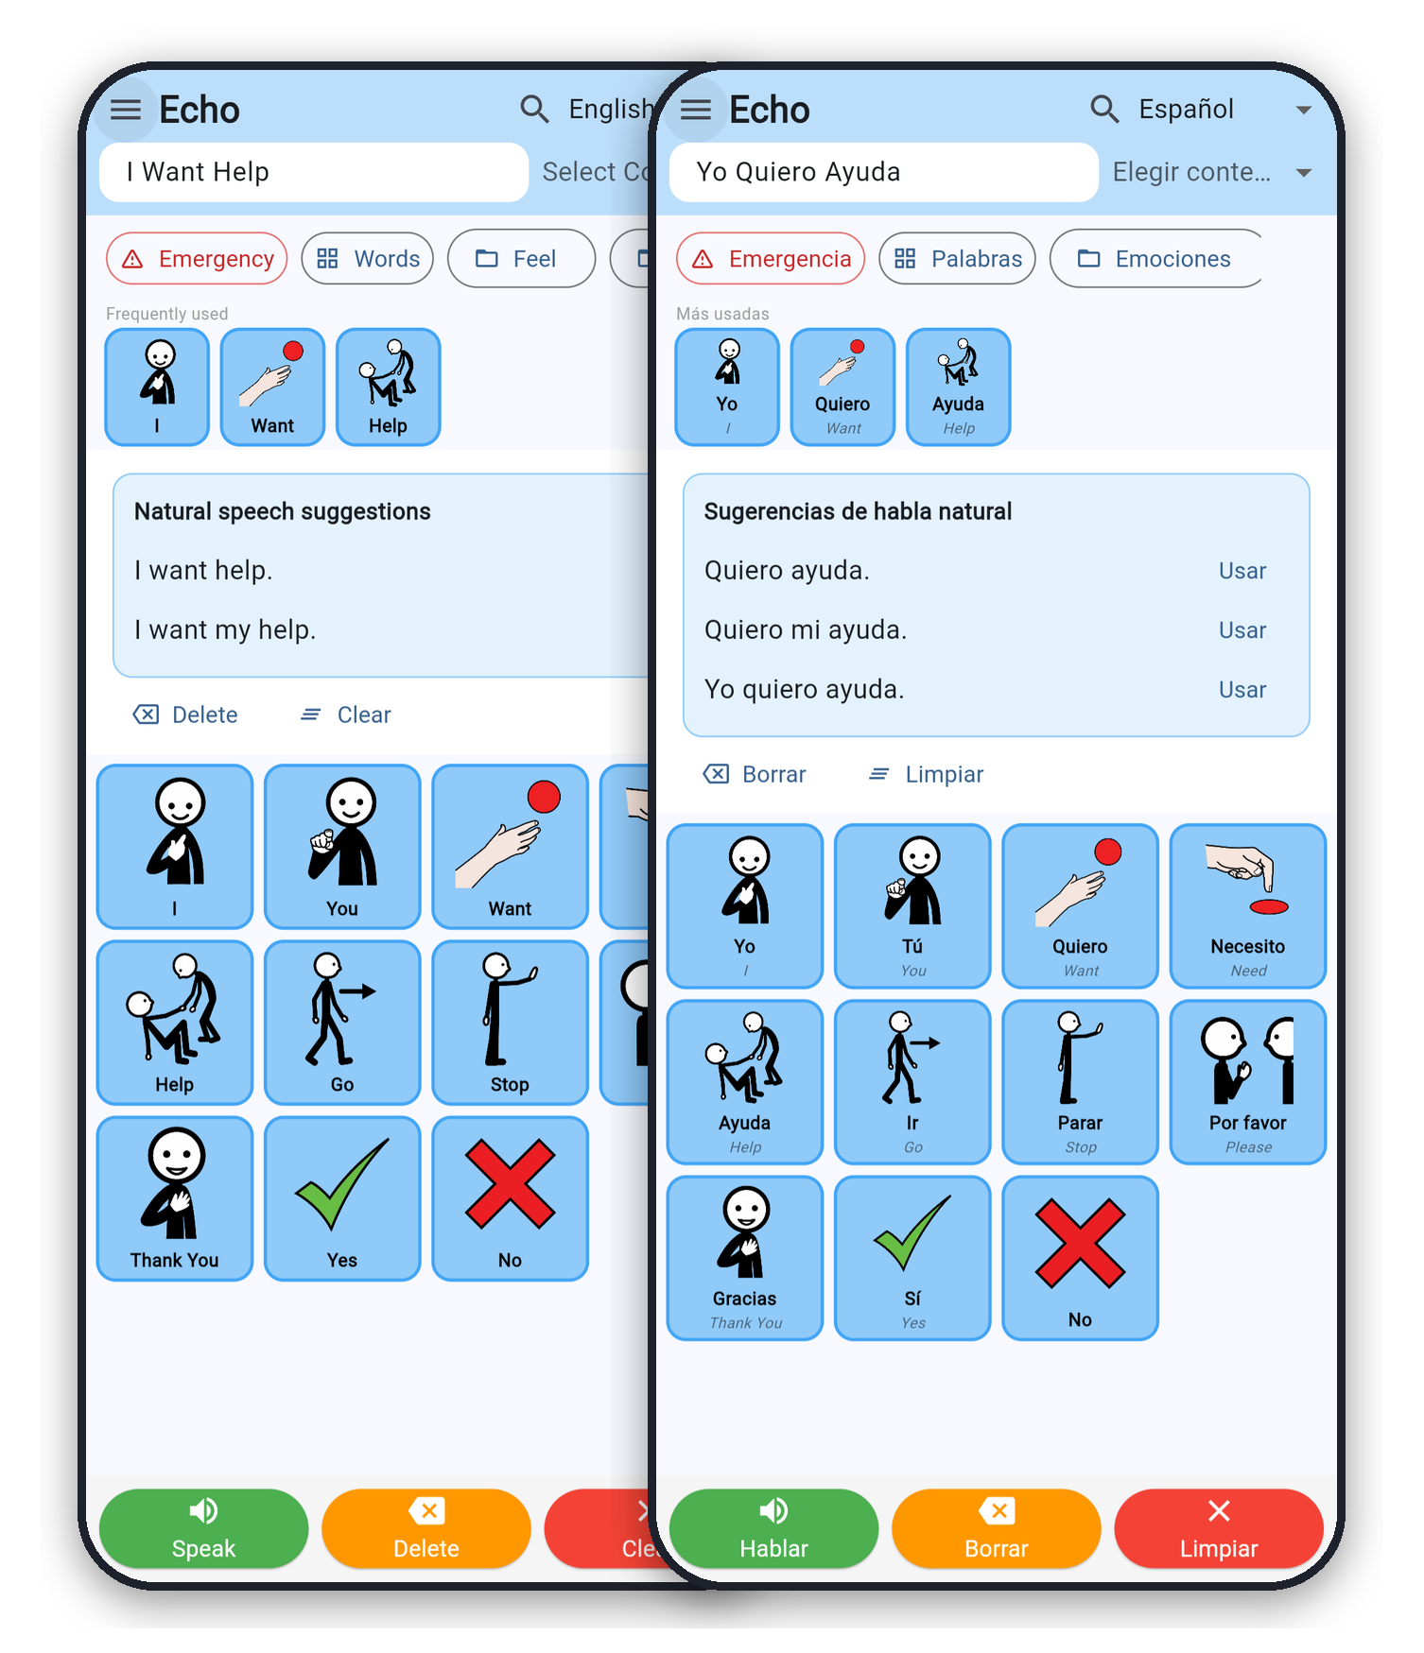
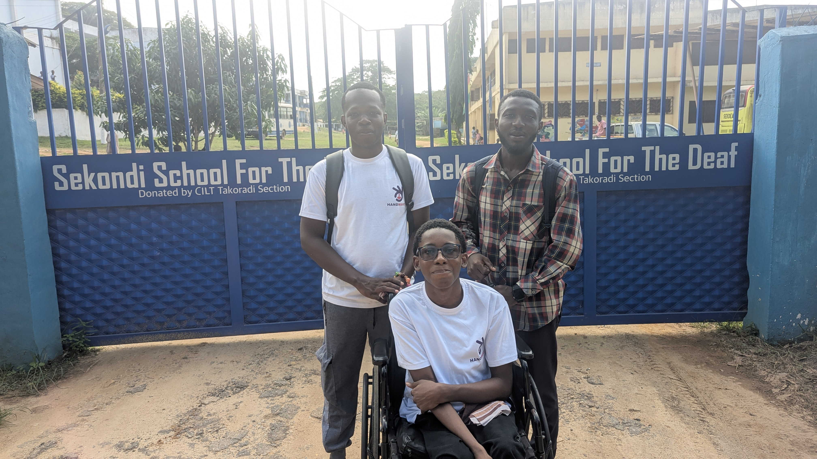
Echo at a Glance: What We Have Built
A working prototype covering the core features, with the remaining items clearly in progress.
78
5
pictograms and photos bundled offline
languages: 3 built, Spanish and French in progress
7
4
contexts, plus 4 collections
access features: speech, scanning, offline, suggestions
9

Slide 7
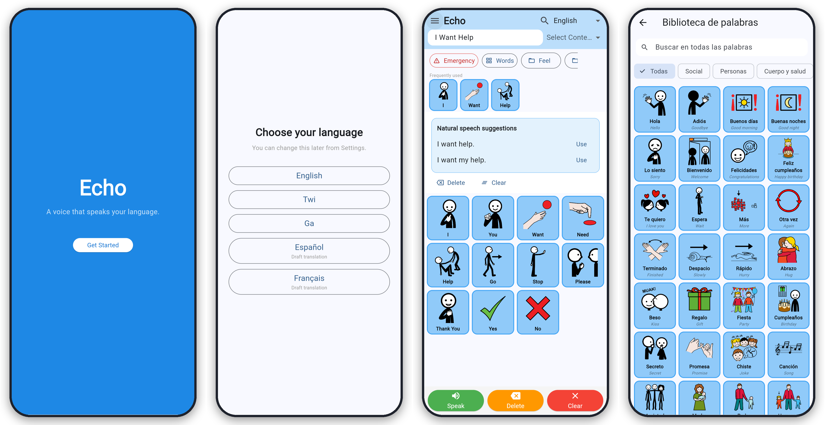
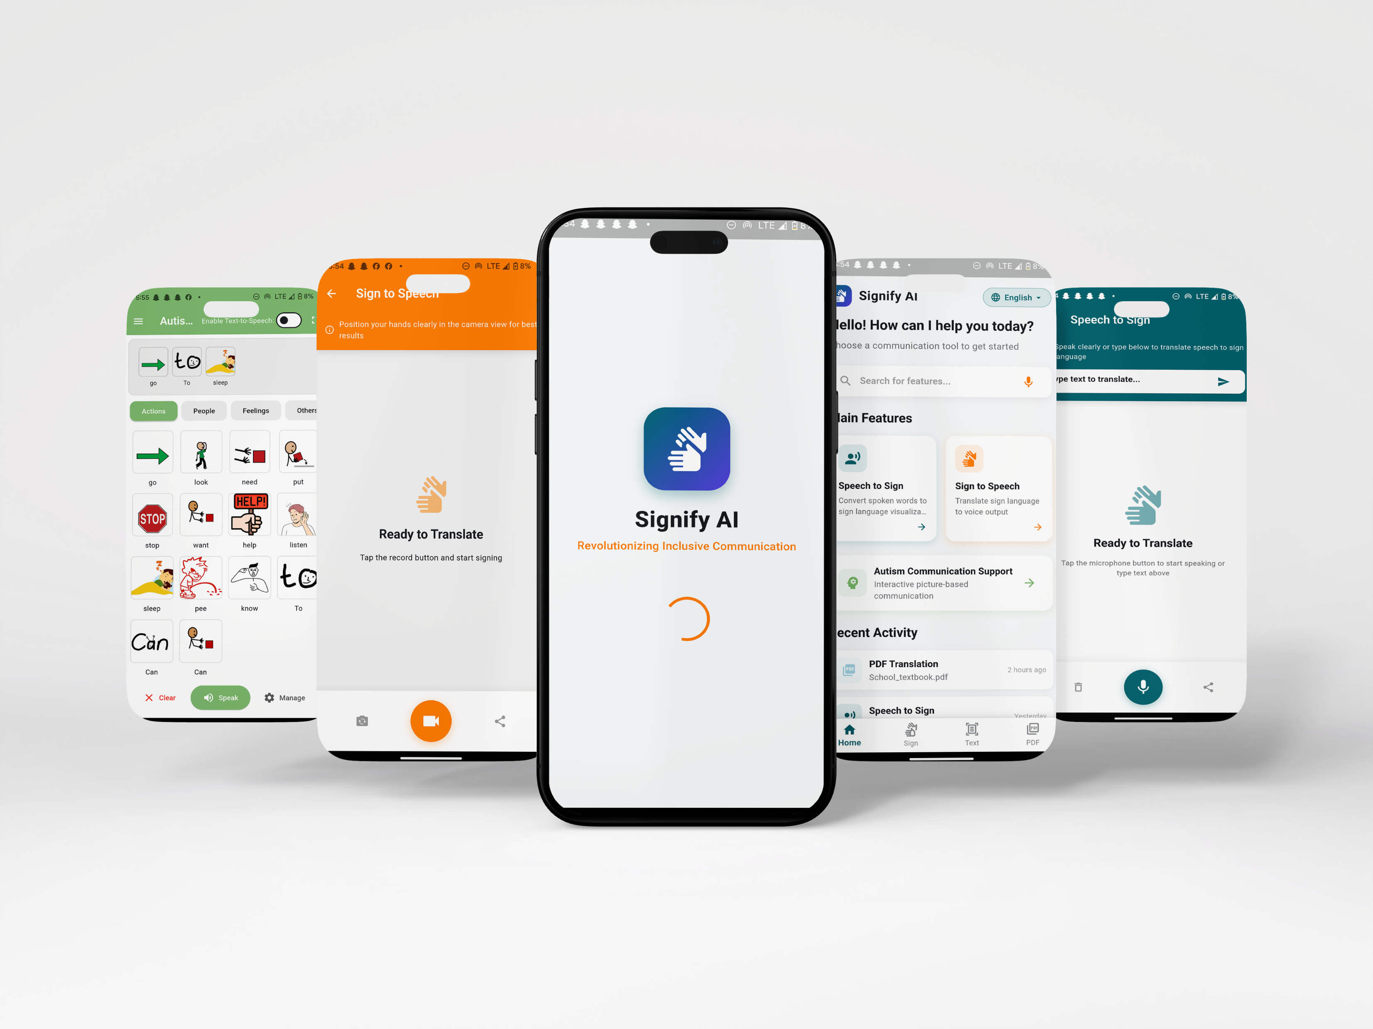
Echo App Prototype
ECHO
06

Slide 8

ECHO
CORE FEATURES
[ICON]
Multilingual Board
Speak in Your Language
Offline-First Design
Natural Speech
English, Twi and Ga tiles with bilingual labels.
Mix languages in one sentence. Status: Built.
Text-to-speech in English, Twi and Ga through Khaya AI, replayed from cache. Status: Built, device testing in progress.
Pictograms and photos are bundled in the app, so the board works without signal.
Status: Built, data storage in progress.
Suggests fuller phrasing. Status: Built (prototype).
07

Slide 9


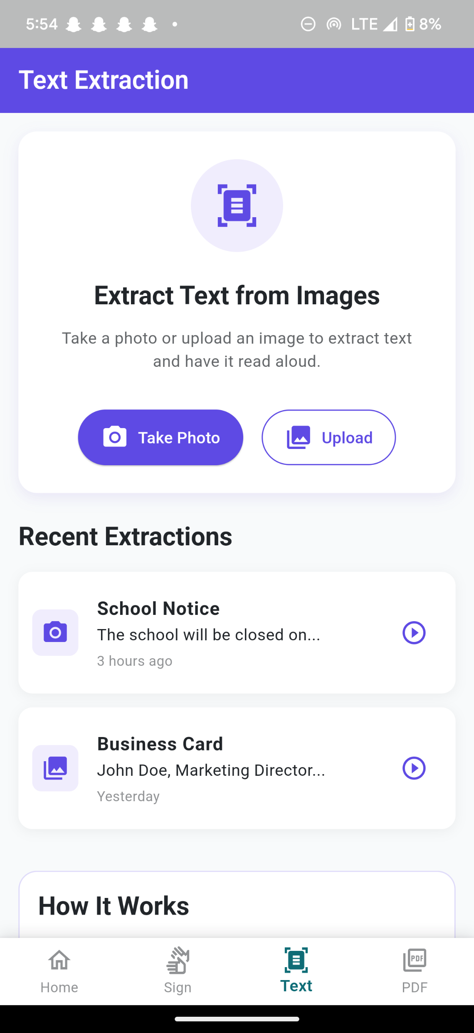

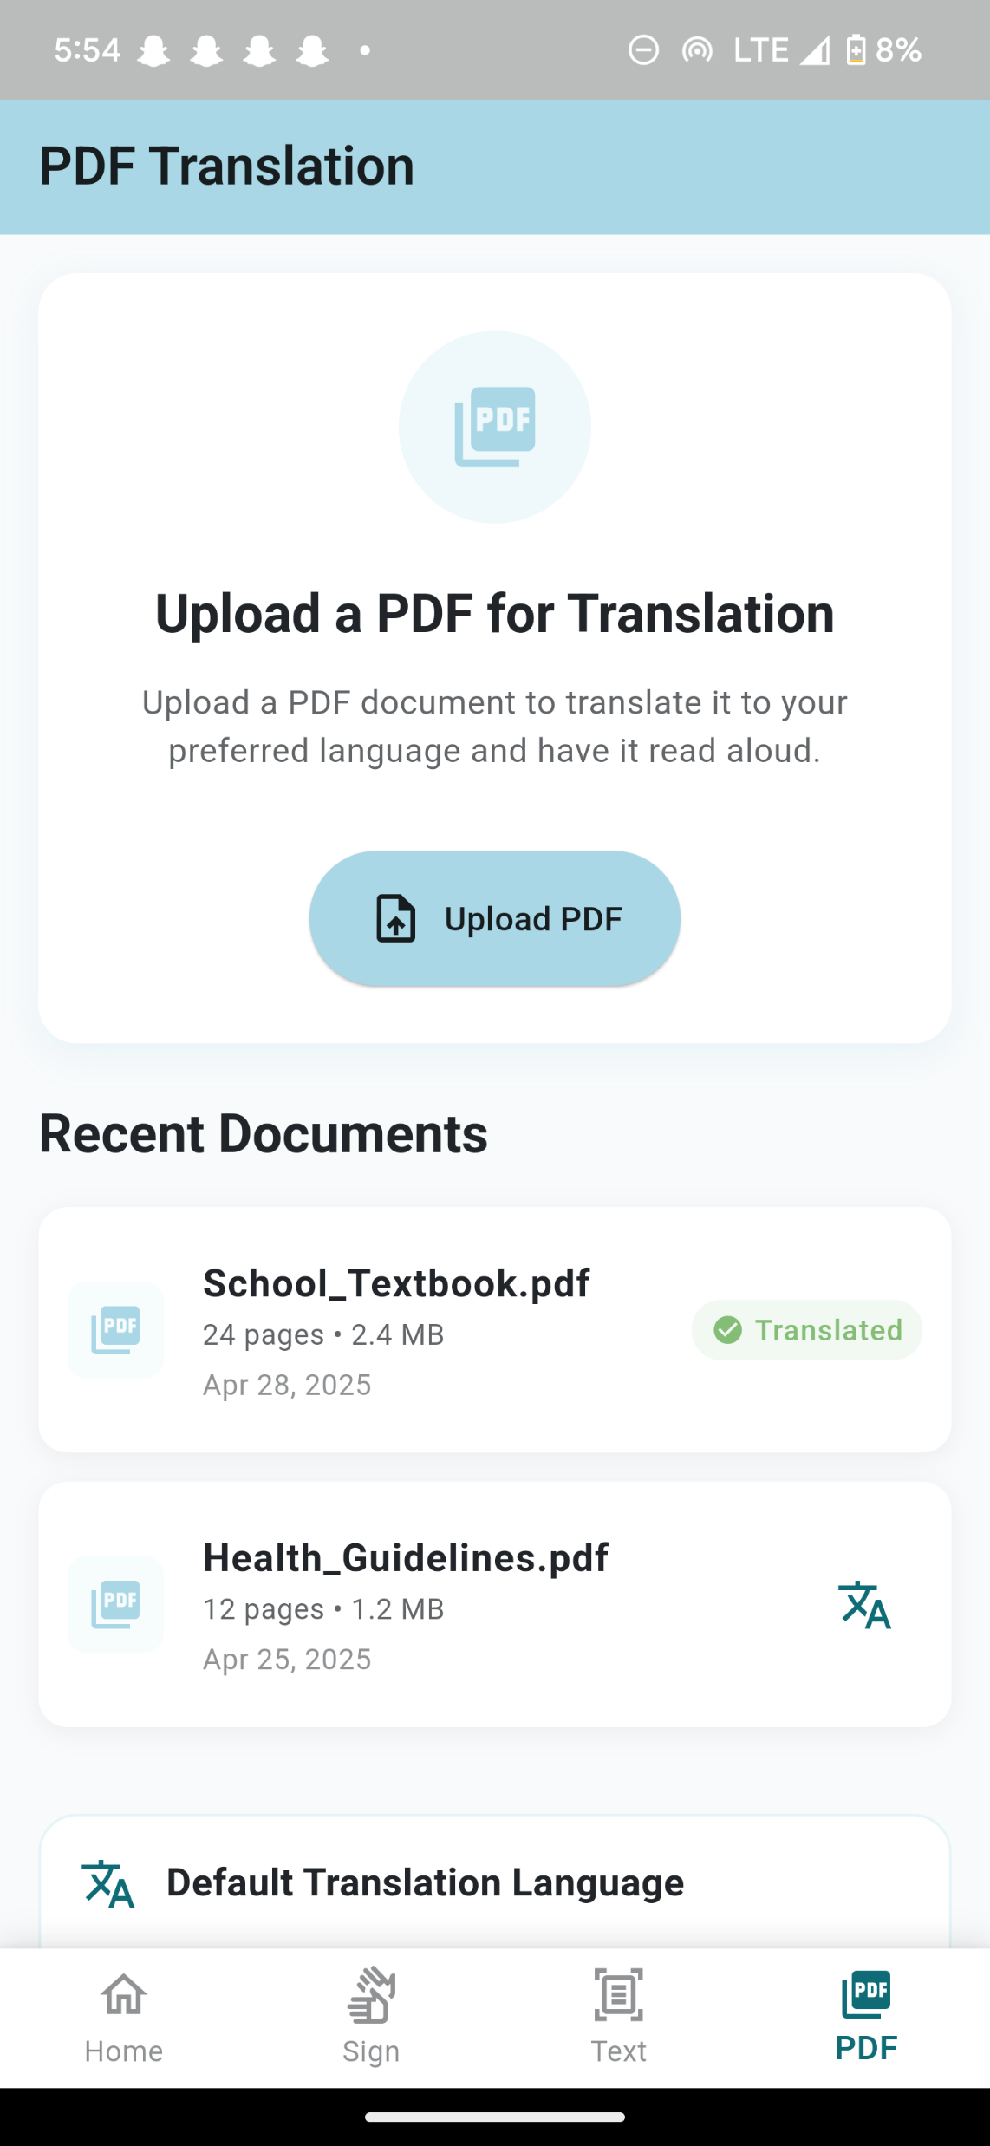
ECHO
CORE FEATURES
[INSERT IMAGE]
App screenshots showing scanning and collections
[ICON]
Switch Scanning
Frequently Used Row
Ghanaian Content
Tiles light up one by one;
a switch or the Space key picks. Status: Built.
Learns your most-used words on the device. Status: Built.
Real photos of fufu, banku, kenkey and trotro. Status: Built.
08

Slide 10
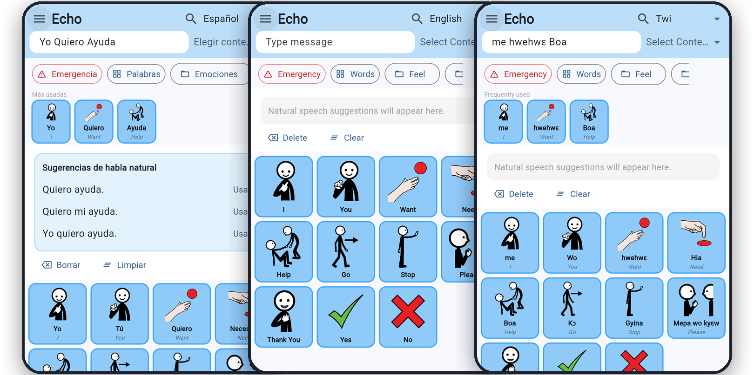
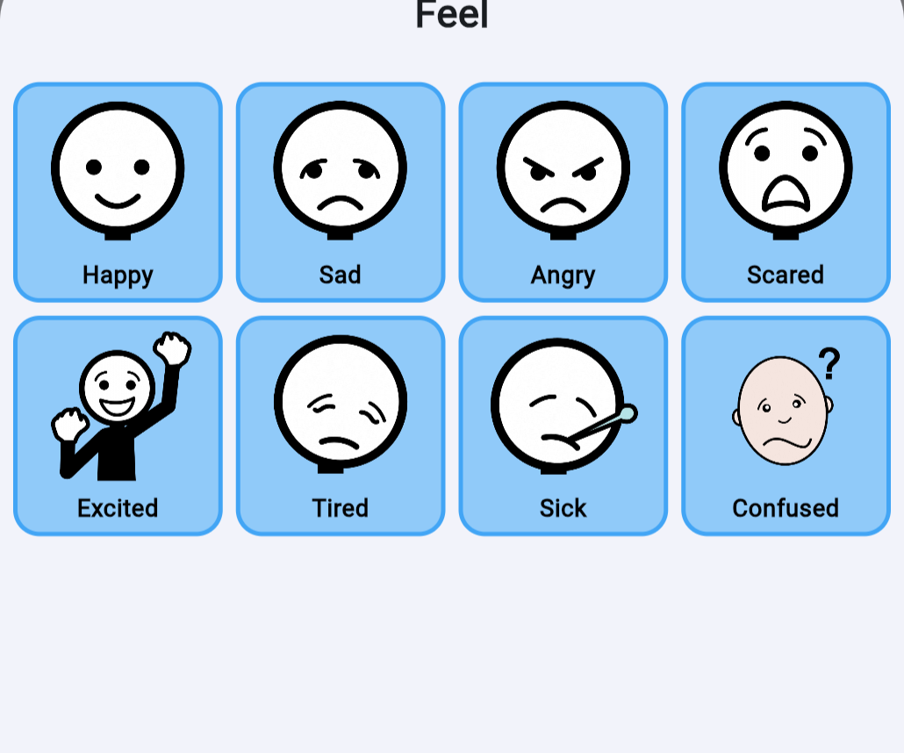
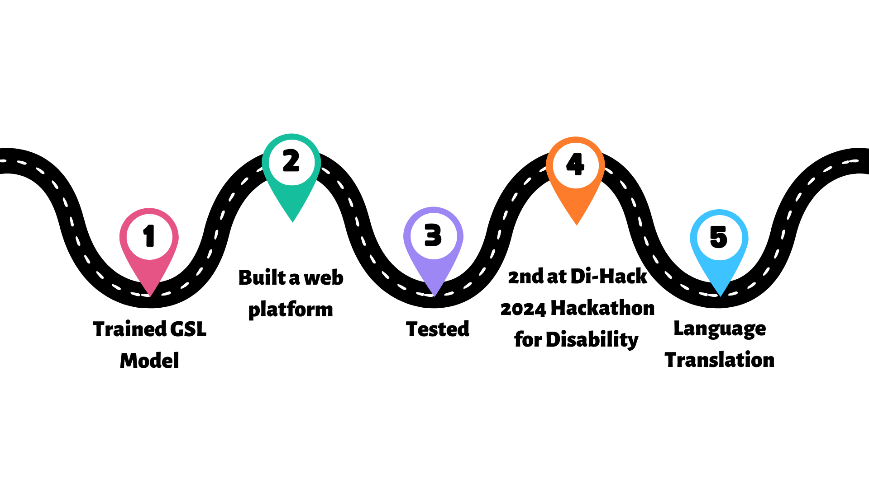
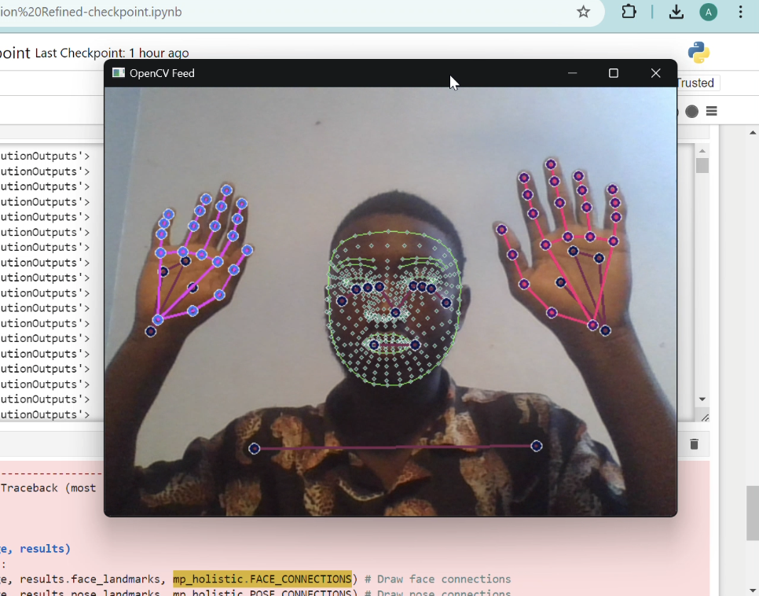
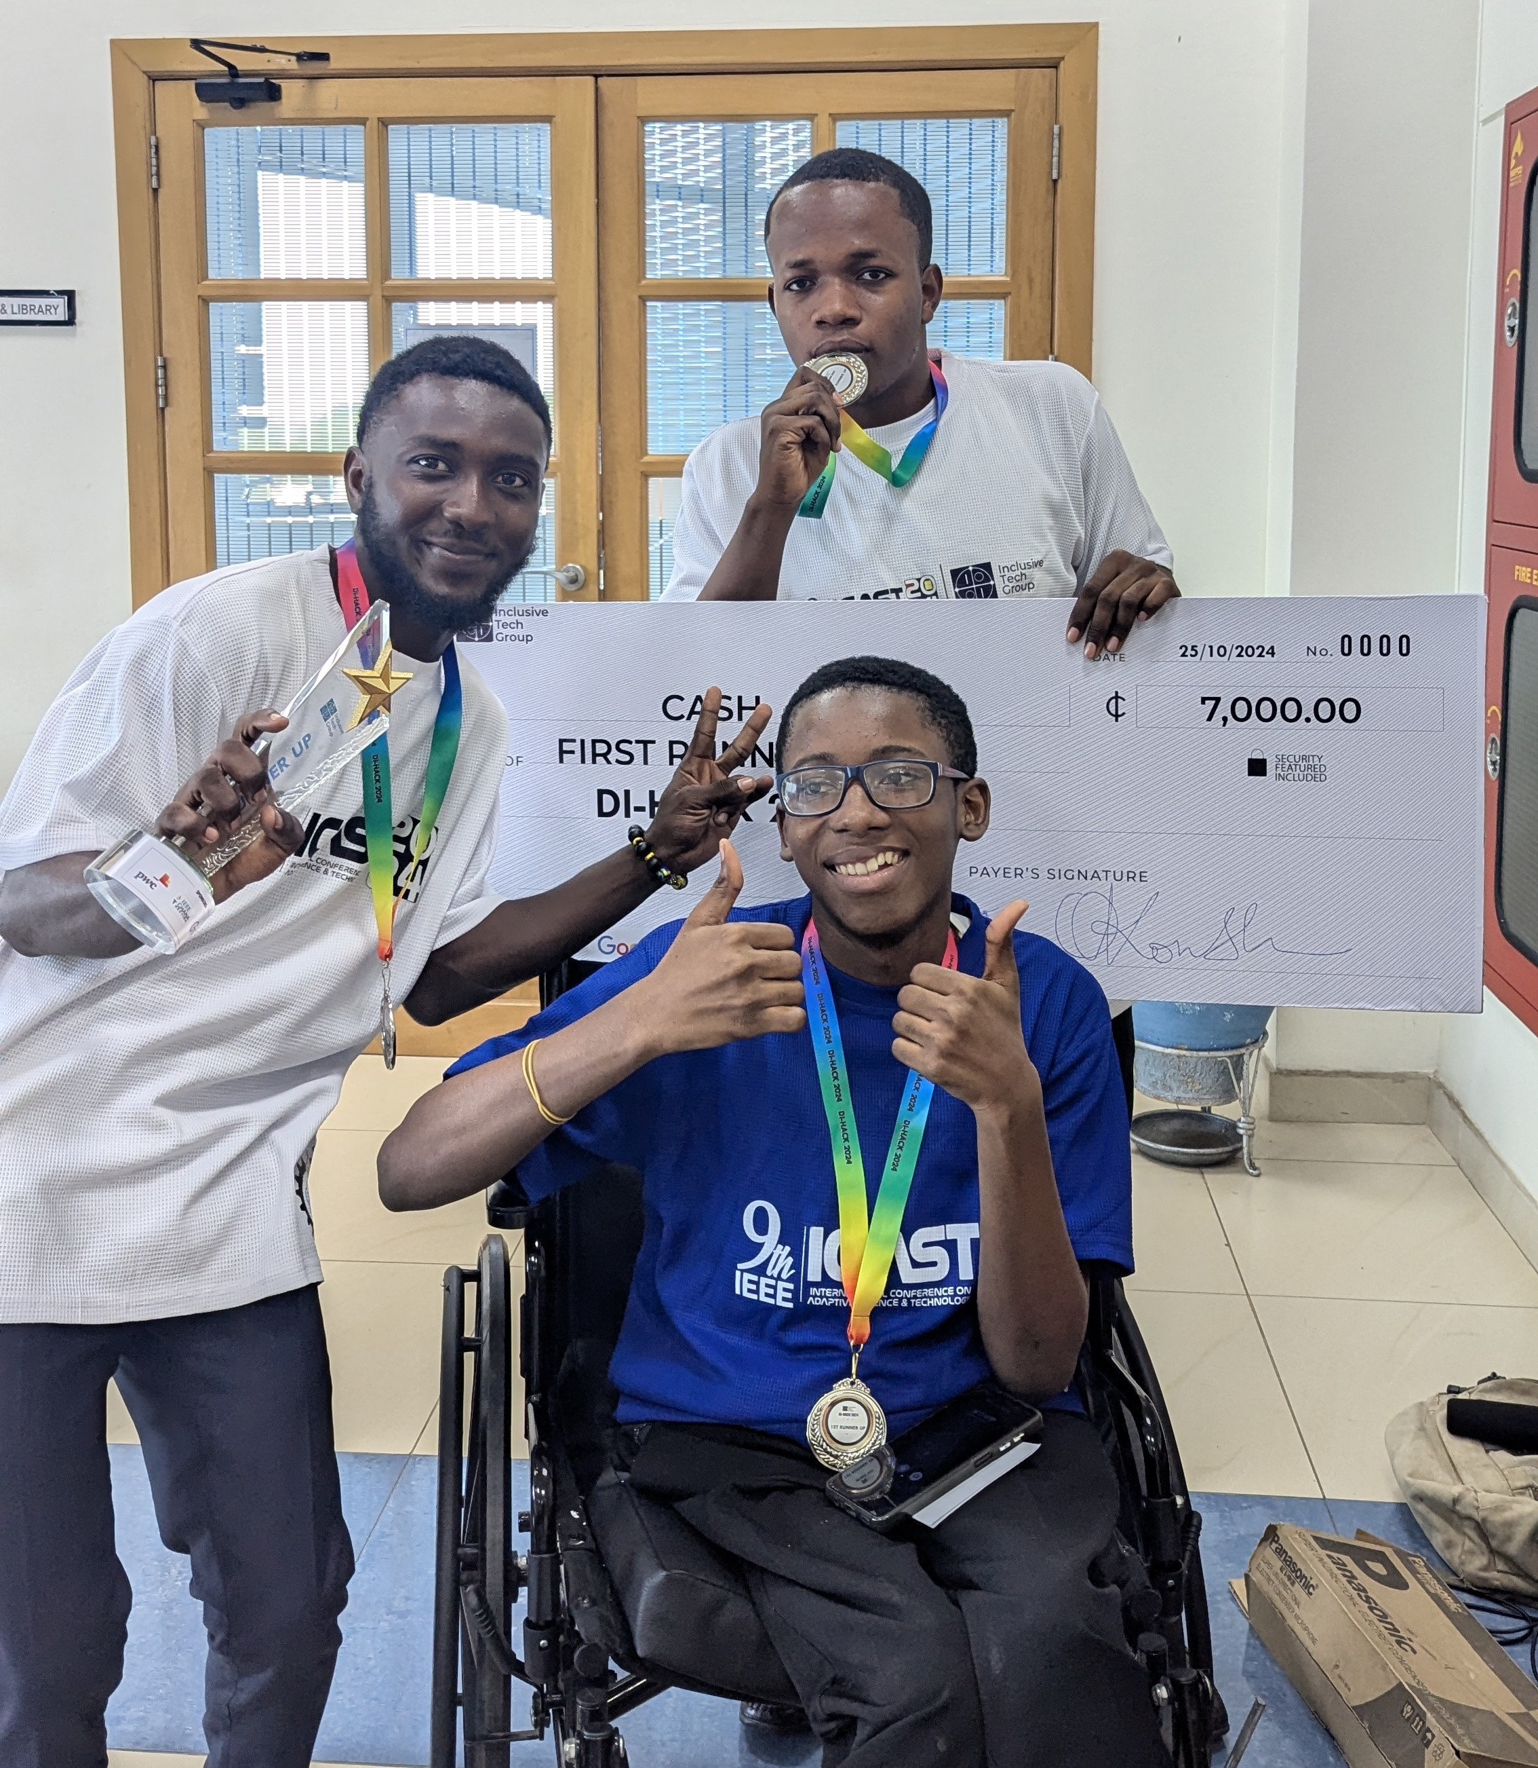
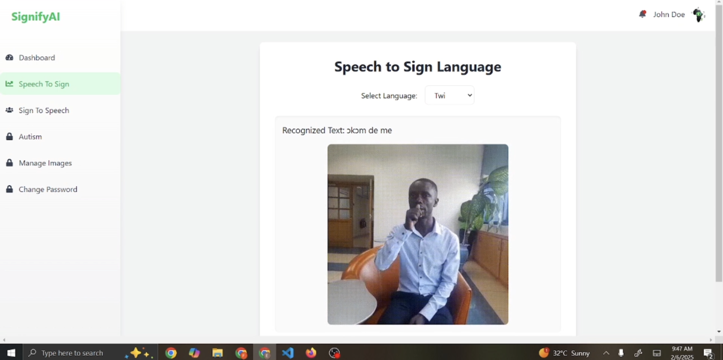
ECHO
OUR JOURNEY SO FAR
[INSERT IMAGE]
Photo
1
2
3
4
5
PRD and research
Built
Flutter board and core vocabulary
Built
Twi, Ga and speech with Khaya AI
Built
Offline pictograms, photos, accessibility
Built
Spanish, French and device testing
In progress
11
09

Slide 11

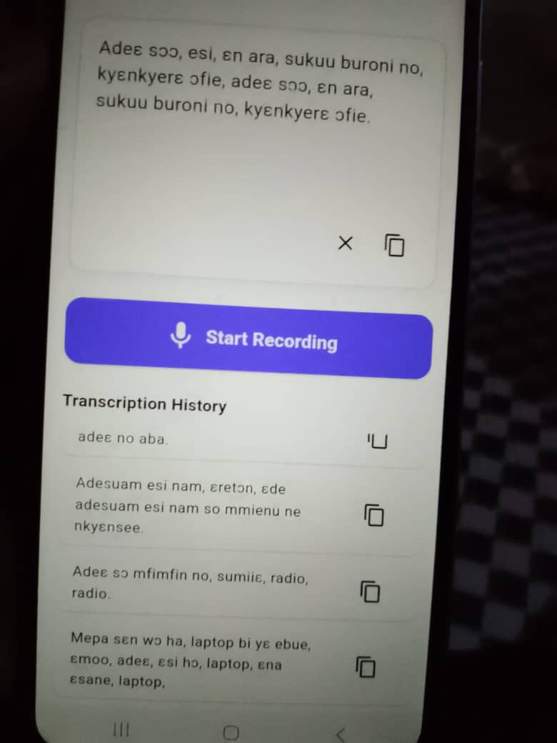
ECHO
TESTING AND FEEDBACK
ANDROID DEVICE TESTING (IN PROGRESS)
EXPERT AND SPEAKER REVIEW (PLANNED)
[INSERT IMAGE]
Photo of Echo running on the phone
[INSERT IMAGE]
Photo from review or testing session
10

Slide 12
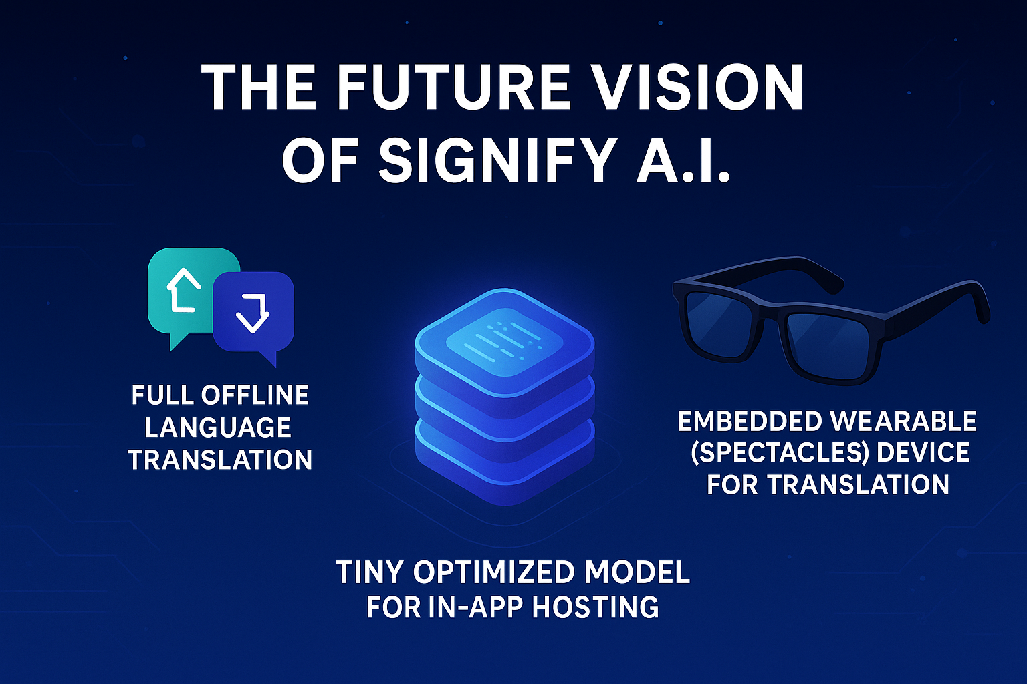
ECHO
Global Language
Roadmap
[INSERT IMAGE]
World map or roadmap graphic
  Now: English, Twi and Ga, built.
  Next: Spanish (600M+ speakers) and French (321M speakers, 62% in Africa), using built-in phone voices.
  Then: any language, through community language packs that anyone can add.
11

Slide 13
The Future Vision Of Echo
More Languages
Add community language packs, starting with Spanish and French, then Ewe, Fante and Dagbani (supported by Khaya AI), each reviewed by native speakers.
Voice Profile and Cloning
Let users record sample phrases so Echo speaks in their own voice, as an enhancement that never blocks communication.
Private and Offline by Design
Keep user data on the device and cache speech, so nothing depends on a live connection and nothing leaves the phone.
Measured Real-World Impact
Pilot with therapists, schools and families on affordable Android phones, tracking taps per message and words per minute.

Slide 14
ECHO
Potential User Base and Target Market
1
PEOPLE WITH CEREBRAL PALSY
2
STROKE SURVIVORS
3
AUTISTIC CHILDREN & FAMILY
4
EDUCATORS AND SPECIAL EDUCATION STAFF
5
6
PEOPLE WITH ALS OR SPEECH APRAXIA
SPEECH AND LANGUAGE PATHOLOGISTS
12

Slide 15

Market Opportunity
Sources: WHO (2023), Elsahar et al. (2019), Instituto Cervantes (2024), OIF (2022)
Each tier below narrows the market down, from everyone who could benefit to who Echo can realistically reach first.
TAM
Total Addressable Market
1.3 billion people live with significant disability (WHO); up to 1% of people have a speech, language or communication need
SAM
Serviceable Addressable Market
Speakers of Twi, Ga, Spanish (600M+ speakers) and French (321M speakers, 62% in Africa): Echo’s first five languages
SOM
Serviceable Obtainable Market
Special-education schools, speech therapists and families in Ghana first, then pilots in Spanish- and French-speaking communities
6

Slide 16
Business Model
Revenue Streams:
  1. Freemium Model (Accessibility-first)
  Free tier: core board, English, Twi and Ga labels, offline pictograms and basic speech.
  Premium tier (planned): voice profile and cloning, extra languages (e.g. Ewe, Fante), user profiles and cloud backup.
  2. B2B Model (Institutional Licensing)
  Special-education schools, hospitals and clinics, speech therapy centres, NGOs and disability advocacy groups.
  3. Vocabulary Packs: Localized vocabulary and photo packs (foods, places, greetings) built with native speakers.
  4. Partnerships: Offer the Twi and Ga language layer to other AAC and education apps.
  5. Grants & CSR Partnerships
13

Slide 17

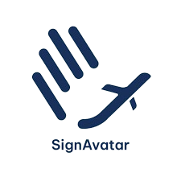

Competitor Analysis
 | Proloquo2Go | TD Snap | SpeakEasy | Echo
Twi and Ga labels and speech | No | No | No | Yes
Mix languages in one sentence | No | No | No | Yes
Ghanaian food and place photos | No | No | No | Yes
Pictograms work offline | Yes | Yes | Yes | Yes
Natural-speech suggestions | Partial | Partial | Yes | Yes
Switch scanning access | Yes | Yes | n/a | Yes
Free, open symbol library | No | No | No | Yes
PAY
14
Competitor features are based on public information and should be re-checked before submission.

Slide 18




IMPACT VISION
  Impact Vision:
  “Inclusion isn’t a feature-it’s a right, therefore we seek to exercise the rights of everyone”
  With Echo, we’re giving people their voice back-in their own languages.
  With Echo, no one has to give up their language or wait for a connection to be heard, anywhere.
  SDG Alignment
15

Slide 19

References
World Health Organization. Disability. Fact sheet, 7 March 2023. https://www.who.int/news-room/fact-sheets/detail/disability-and-health
World Health Organization. Autism. Fact sheet, updated 17 September 2025. https://www.who.int/news-room/fact-sheets/detail/autism-spectrum-disorders
Elsahar, Y. et al. (2019). Augmentative and Alternative Communication (AAC) Advances: A Review of Configurations for Individuals with a Speech Disability. https://pmc.ncbi.nlm.nih.gov/articles/PMC6515262/
National Institute on Deafness and Other Communication Disorders. Aphasia. https://www.nidcd.nih.gov/health/aphasia
Instituto Cervantes. El español en el mundo 2024. https://cvc.cervantes.es/lengua/anuario/anuario_24/
Organisation internationale de la Francophonie. La langue française dans le monde 2022. https://www.francophonie.org
Government of Aragón. ARASAAC pictograms (author Sergio Palao), licensed CC BY-NC-SA. https://arasaac.org
GhanaNLP. Khaya AI translation and text-to-speech API. https://developer.khaya.ai
Wikimedia Commons contributors. Photos of Ghanaian dishes and tro tro, CC BY-SA 4.0 and CC BY 2.0 (credits in the app’s About screen). https://commons.wikimedia.org
AssistiveWare, Proloquo2Go, and the SpeakEasy project (github.com/enzomar/speakeasy): design and architecture references.
Echo — Business Plan
15

Slide 20

[INSERT IMAGE]
Echo logo
TEAM HANDWAVE
Giving Voice to the Unheard-In Every Language
Contact
ce-pobekoe1423@st.umat.edu.gh
+233-246-467-996/ +233-544-883-507
Thank
You
PAY
16

